Slide 1

BTECH (CSE) CAPSTONE PROJECT
Topic: Three-Tier Voting System
Group Members:
Shayan Saha (14BCE1047)
Abhilash Gupta (14BCE1153)
Sarvansh Prasher (14BCE1155)
Project Guide:
Dr. B V A N S S Prabhakar Rao

Slide 2
Presentation Flow
Problem Definition
Abstract
Proposed System
Importance of Project
Basic Structure
Hardware Requirements and Software Requirements
Modules
Challenges Involved
Literature Survey
Advantages associate with our system security
Conclusion

Slide 3
Problem Definition
Developing an authenticated system that provides integration of trio security features such as face recognition initially and after that One Time Password or key generation and matching and, then we will implement the concept of cryptography in order to enhance the security level.

Slide 4
Abstract
The existing voting system is based on ballot machine where when we press the button corresponding to the symbol, the voting is done. Here there is a security risk, the person who votes may be fake person voting. The people there might not know that a person is using fake voting card, this may cause problem.

Slide 5
Proposed System
The proposed system is an integrated system that provides three layers of security which is basically divided into three modules.
In the first module security is provided by face recognition. The voter’s image is captured and compared with the image stored in the database, if it matches then at the same time first 4-digit of the Aadhar card number of that person is taken.
In the second module One Time Password or key is generated which is displayed in the 7 segments. The four digit key will be encrypted and stored into database . After that we set up back-end server on PI to match , store and delete passwords .
The voter will note that key or password as he needs to enter that key or password. At that time if the encrypted version of the user entered pin matches with the encrypted data stored in the database and which was previously sent over WIFI module from the second tier then the candidate can cast their vote and the casted vote is accepted. Thus, the intended system will provide more security than the existing systems.

Slide 6
Importance of Project
The proposed system takes cares of the voting process very efficiently and the discrepancy in voting system which were observed at the previous system(ballot paper and EVM) can be taken care of.
Inside the control unit, hidden from the person is three tier security that takes care of common election errors or malpractices like duplication vote
This system will count the votes automatically so the counting process will be faster and that will help to publish the result faster.

Slide 7
Motivation
The current voting systems which are prevalent currently in various countries are working exceptionally well, but there is an ever increasing cost associated with them. Every year reports of malpractices can be seen in the news. Also, they are outdated and require human and natural resources which are ever declining. There is a need of these voting system to come to date with a technology, especially with the advent of automation and machine learning.
So to accomplish this we are trying to set up a system which can improve the current scenario.

Slide 8
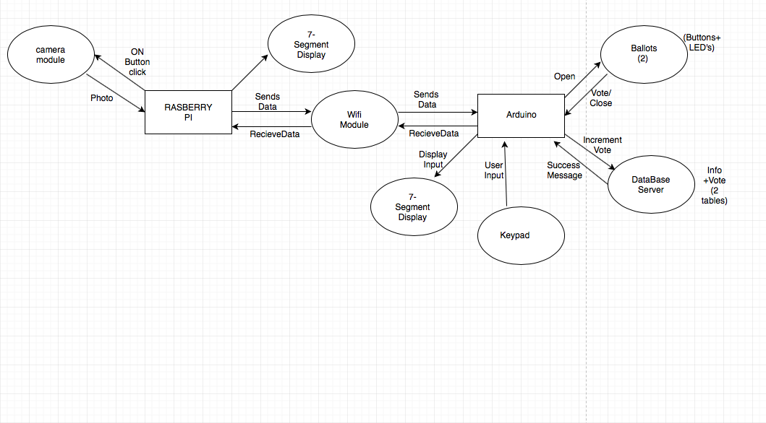
Basic Structure

Slide 9
Hardware and Software used
Hardware
Raspberry pi
Raspberry pi Camera module
Arduino Mega 2560
WIFI Module
LCD Display
Keypad
Software
Dlib Library
Python
SQL or File
Arduino

Slide 10
Modules
MODULE 1 :
Setting up Raspberry PI (Installing Operating System, Setting up Python, Installing face recognition and other libraries onto Python).
Setting up PI Camera with the desired resolution.
Designing database to store Voting data, Passwords and Security PIN.
MODULE 2:
Setting up display on Raspberry PI to show Password generated.
Setting up connection between Arduino and Raspberry PI through WIFI.

Slide 11
Setting up back-end server on PI to match, store and delete passwords.
Setting up displays and keypads on Arduino.
MODULE 3:
Working with buttons to detect input from the voter.
Locking EVM after a single vote or multiple wrong password attempts.
Encrypt the data or the casted vote and send it to the server or database and map it with the individual Aadhar number.

Slide 12
Challenges Involved
The Pose , Illumination and Scars regarding to the facial recognition.
Redundancy of One Time Key.
Scalability of application(Real time implementation).
Power source problem.
Adjusting to the new system is difficult.
Regional difficulties like language problems and illiteracy.

Slide 13
Literature Survey
CURRENT VOTING SYSTEM
On entering the polling station, one has to go to the First Polling Officer who is in-charge of the marked copy of the electoral roll and responsible for identification of electors. One needs to keep the identity document ready to show to the First Polling Officer. The First Polling Officer will then call out the name and serial number so that the polling agents become aware of the person's presence and the identity is not challenged.

Slide 14
Following this, if the person's identity is not challenged, he/she will move to the Second Polling Officer who will mark the left forefinger with the indelible ink. Following this, the person’s serial number is recorded by the Officer in the Register of Voters. Once this is recorded, the voter must sign in the appropriate column in the Register of Voters. If a voter cannot sign, his/her thumb impression will be obtained. The Second Polling Officer will then give you a signed voter's slip which will record your serial number in the register of voters and your serial number in the electoral roll.

Slide 15
Operating the Voting Machine
Inside the voting compartment, the voter has to press the blue candidate button on the Balloting Unit against the name and symbol of the candidate of the voter's choice. On the candidate button being pressed, the red lamp will glow against the name and symbol of that candidate. There will also be a beep sound heard to indicate that the vote has been recorded and the Busy lamp goes off in the Control Unit.

Slide 16
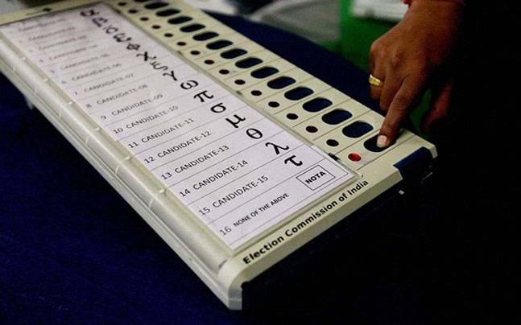
Electronic Voting Machine

Slide 17
Advantages associated with our system
Security
The system is free from intentional tamper. It is not possible to hack the machine. Though this factor depends on the personnel integrity, attempts should be made to make the model as secure as possible. In this machine every user has to undergo Facial Recognition. The votes will be successful only after successful verification of their face.

Slide 18
Reliability
The machine registers the votes aptly. A vote is never altered. A valid vote is never eliminated, from the final tally and an invalid vote is not counted. The final vote tally must be perfect. Most important thing the votes are stored in PI memory, where the numbers of votes are stored permanently.

Slide 19
Flexibility
In this method the design of the system is such that it can be put to use in various polling systems, with different requirements and mechanisms.

Slide 20
Using Electronic circuitry
Inside the control unit, hidden from the person is three tier security that takes care of common election errors or malpractices like duplication vote. For instance, if one were to press two or more buttons simultaneously, then no votes supposed to be cast.
Even if there was a micro-second difference in the pressing of the switches and the EVM is sensitive enough to trace and identify the switch that was press first.

Slide 21
Hi-tech Simplicity
To commence polling, the polling officer activates the "Ballot" switch on the control unit. The voter then has to press the button of his choice on the ballot unit. This is followed by a short beep sound, indicating that the vote has been cast. Once again, the polling officer has to press the "Ballot" switch to clear the machine for the next voter to cast his vote. But in case of our proposed system there is no requirement of polling officer.

Slide 22
Automatic Counting
This system will count the votes automatically so the counting process will be faster and that will help to publish the result faster.

Slide 23
CONCLUSION
Our project enables secured voting and reduces man power efficiently. Due to the introduction of facial recognition, one time password , cryptography we are able to make the polling more secure.

Slide 24
Feasibility Study
Our project is technically feasible as all the technical resources required for the project are available to us .We have Raspberry pi and Pi camera which we will use for face detection . Every component used in the proposed voting system is available to us which makes the project a feasible one. The best part of our project is that it doesn’t involve man power and its is cost efficient.

Slide 25
THANK YOU

